Slide 1
Problem statement
Exercise 3.
Using Veitch diagrams, simplify the following Boolean function:
8.

Slide 2
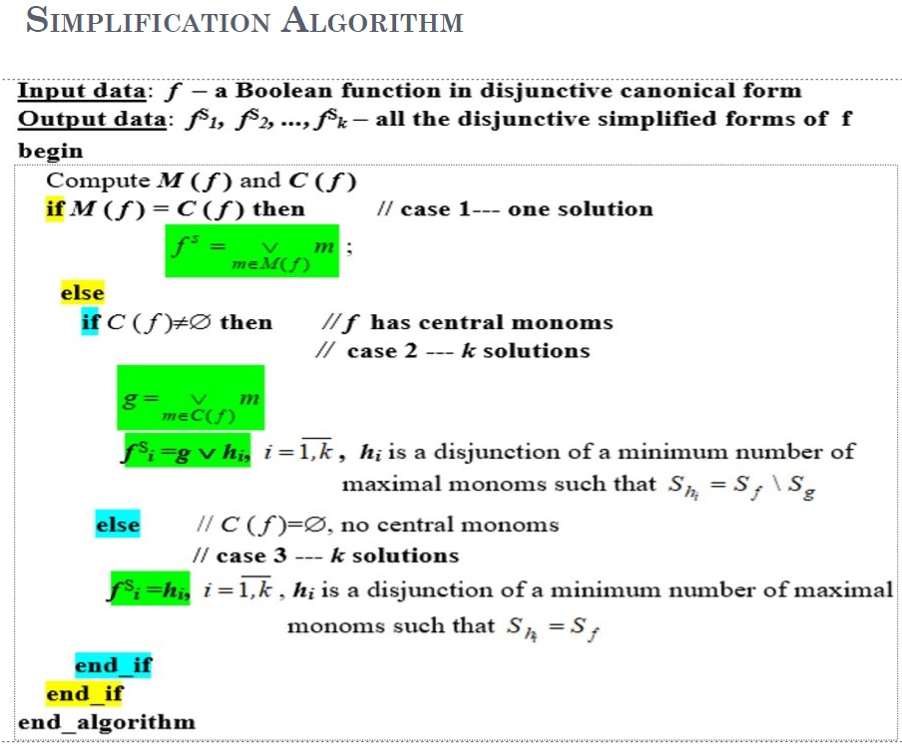
Theoretical results

Slide 3
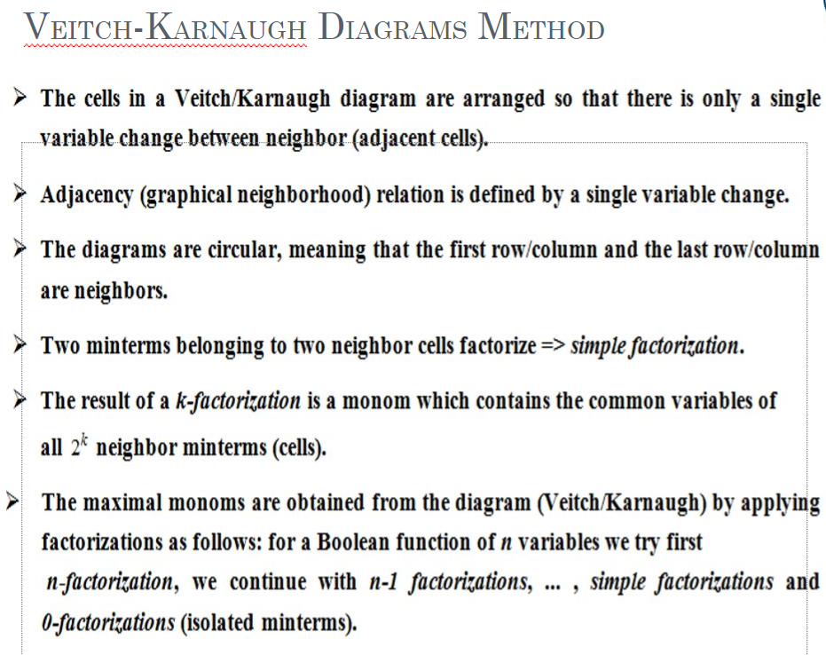

Slide 4
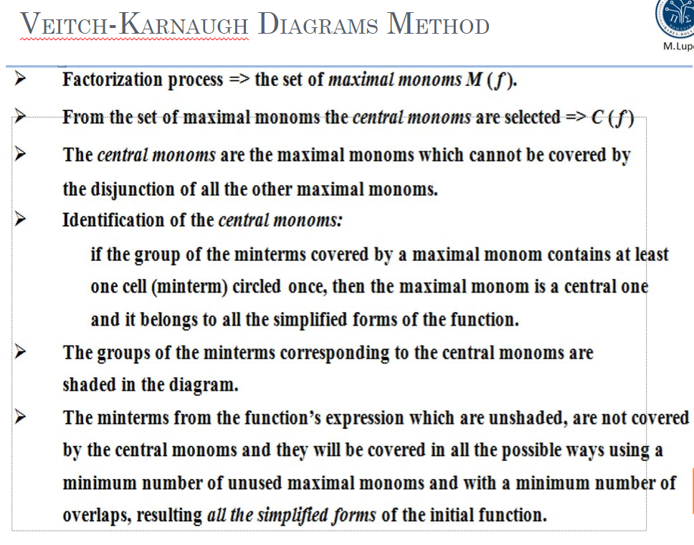

Slide 5


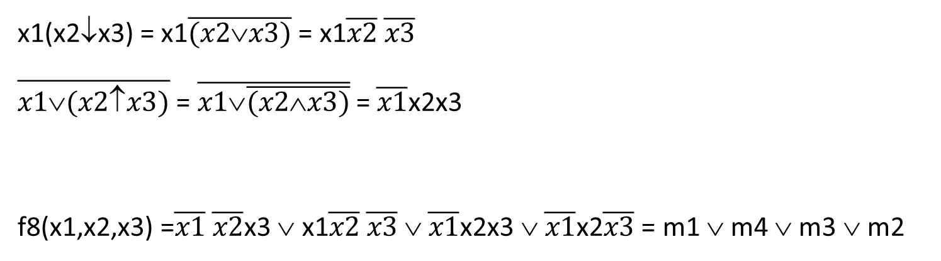
Solution
x1(x2↓x3) = x1$\overline{(x2∨x3)}$ = x1$\overline{x2} \overline{x3}$
$\overline{x1∨(x2↑x3)}$ = $\overline{x1∨\overline{(x2∧x3)}}$ = $\overline{x1}$x2x3
f8(x1,x2,x3) =$\overline{x1} \overline{x2}$x3 $$ x1$\overline{x2} \overline{x3} $ $\overline{x1}$x2x3 $$ $\overline{x1}$x2$\overline{x3}$ = m1 $$m4 $$m3 $$m2

Slide 6
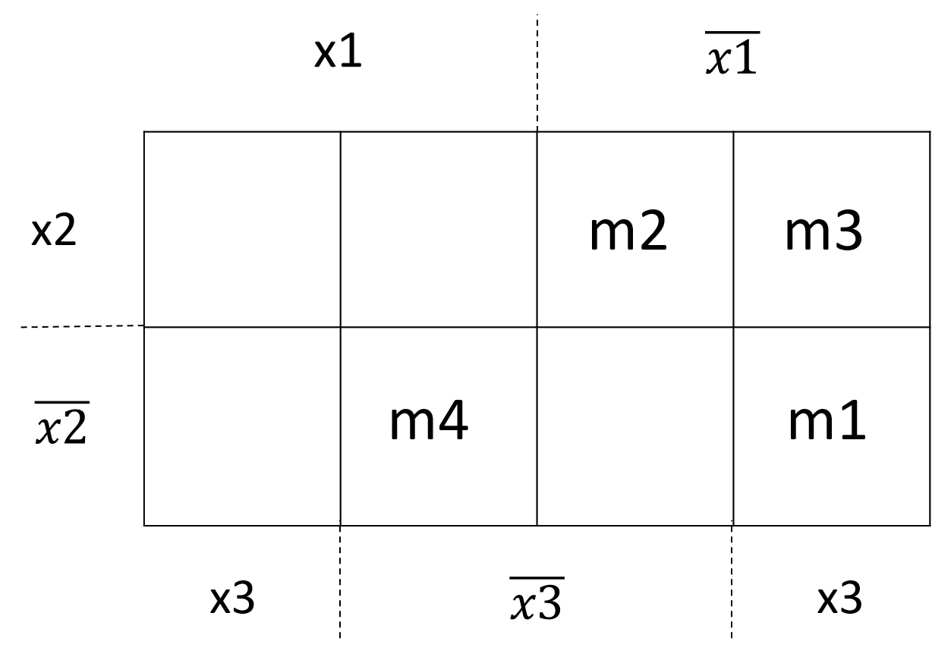
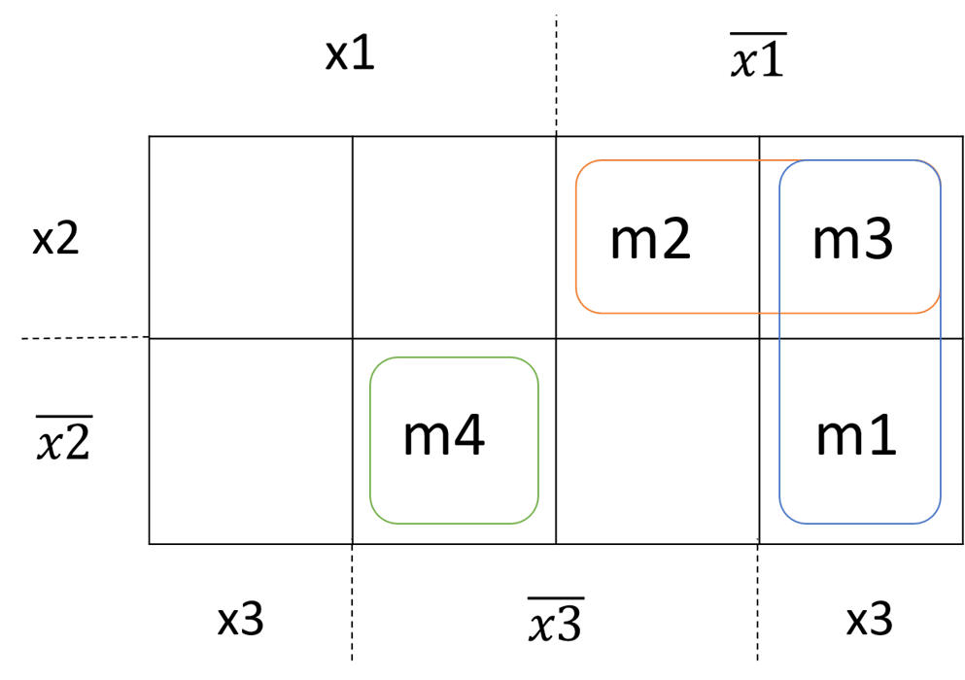
Veitch diagram
Factorization process
two groups of 2 neighbor minterms
one isolated minterm

Slide 7
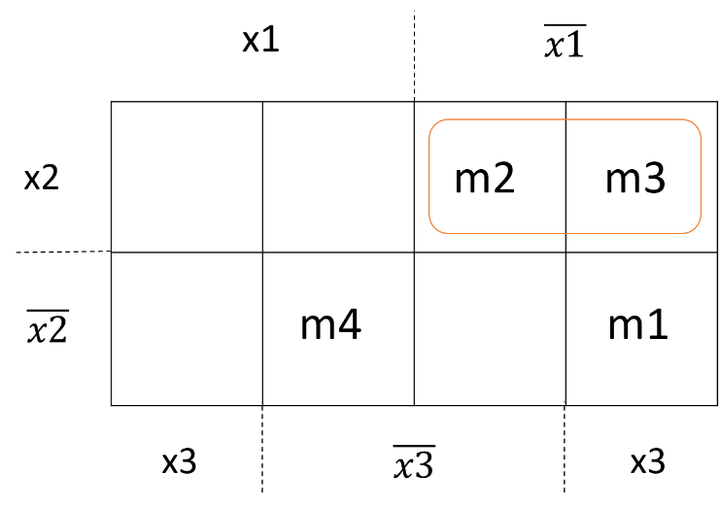
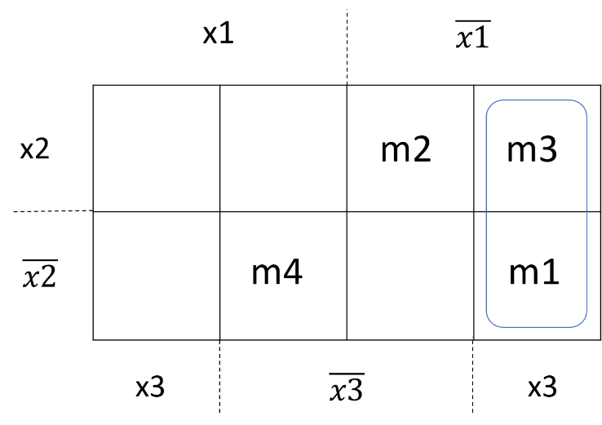
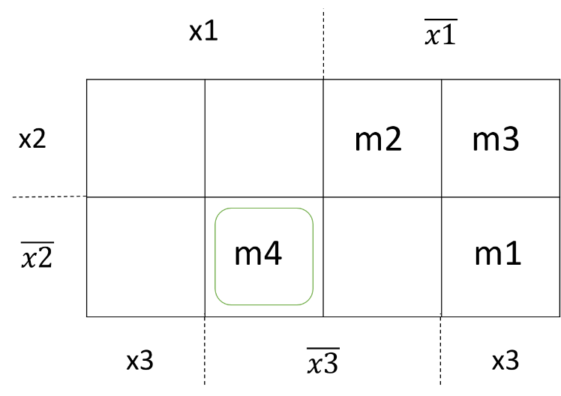
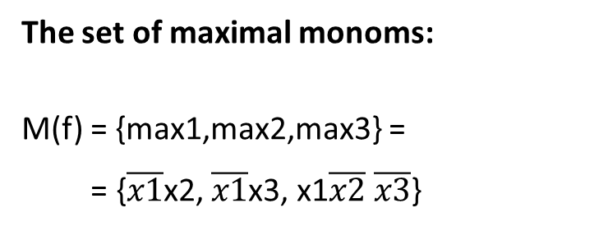



simple factorization
simple factorization
max1 = m2 $$m3 = $\overline{x1}$x2$\overline{x3}$ $$ $\overline{x1}$x2x3 = $\overline{x1}$x2
max2 = m3 $$ m1 = $\overline{x1}$x2x3 $ \overline{x1}$ $\overline{x2}$x3 = $\overline{x1}$x3
0-factorization
The set of maximal monoms:
M(f) = {max1,max2,max3} =
= {$\overline{x1}$x2, $\overline{x1}$x3, x1$\overline{x2} \overline{x3}$}
max3 = m4 = x1$\overline{x2} \overline{x3}$

Slide 8
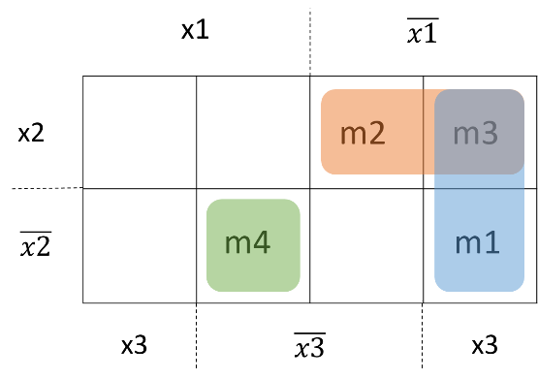
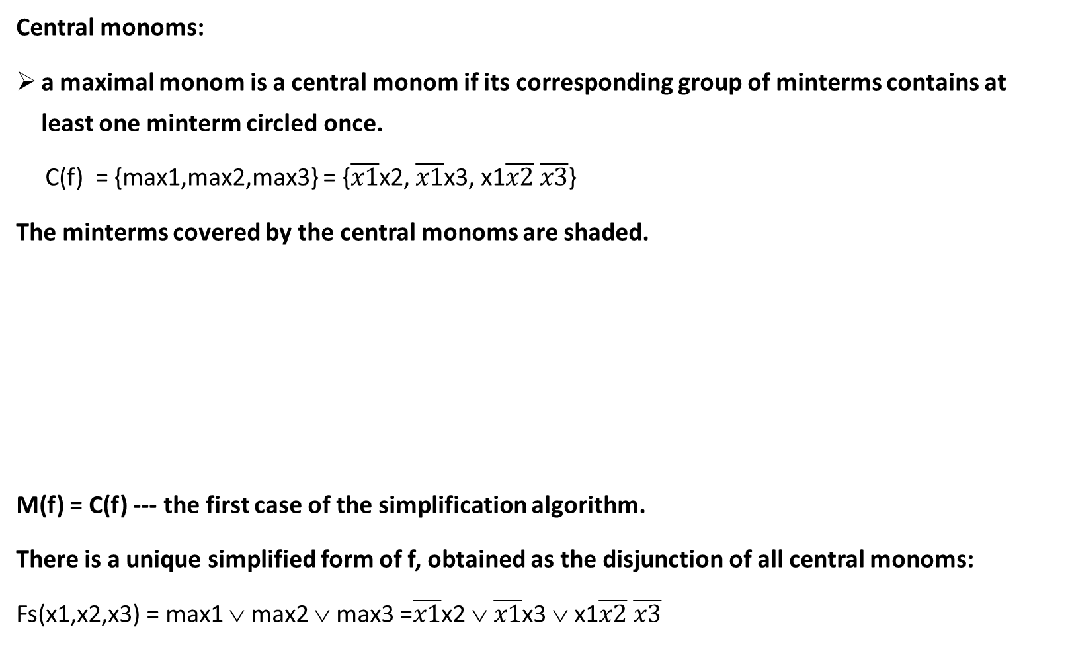
Central monoms:
a maximal monom is a central monom if its corresponding group of minterms contains at least one minterm circled once.
C(f) = {max1,max2,max3} = {$\overline{x1}$x2, $\overline{x1}$x3, x1$\overline{x2}$ $\overline{x3}$}
The minterms covered by the central monoms are shaded.
M(f) = C(f) --- the first case of the simplification algorithm.
There is a unique simplified form of f, obtained as the disjunction of all central monoms:
Fs(x1,x2,x3) = max1 $$ max2 $$ max3 =$\overline{x1}$x2$$ $\overline{x1}$x3 $$ x1$\overline{x2} \overline{x3}$

